Slide 1
PredictIOn of diabetes
Project Mentor :
Prof. Arnab Chakraborty
Team Members :
Subhajit Ghatak
Saurabh Thakur
Ashish Dungdung
Charanjit Singh
Smriti Sengupta

Slide 2
Contents
Project Objective & Scope
Data Description
Methodology
Data Preprocessing
Selecting Principal Attributes
Models Used
Accuracy Comparison
User Interface
Future Scope of Improvements

Slide 3
Project objective & scope
Objective:
Given : A small diabetes prediction dataset taken from Kaggle.
Goal : To Predict whether a person is diabetic or not based upon applicant data.
Finally : Apply on the test data and compare the differences in the results.
Scope :
It is a useful project as the Classifier models can be used to quickly predict diabetics of large datasets.
The results might have some mismatch with the real-world applications. But that can be avoided if the models are trained for small datasets.

Slide 4
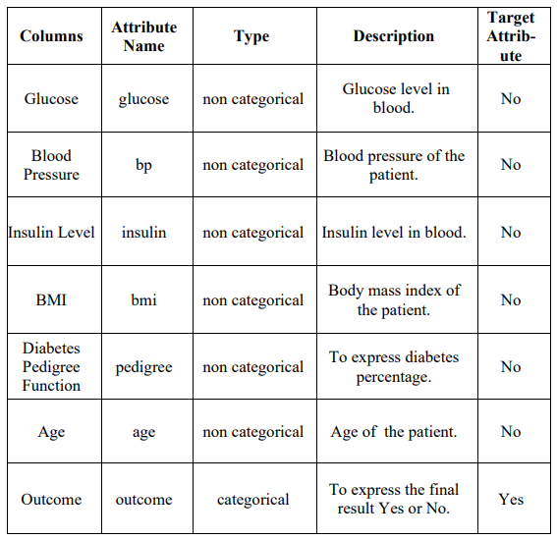
Data description
The description of the data with type and description of each Attribute is given/shown in the table.

Slide 5
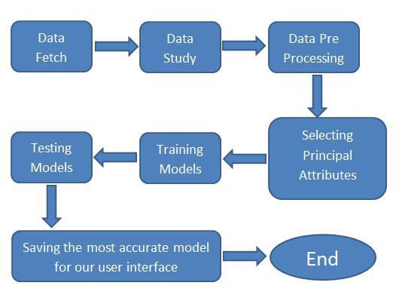
Methodology

Slide 6
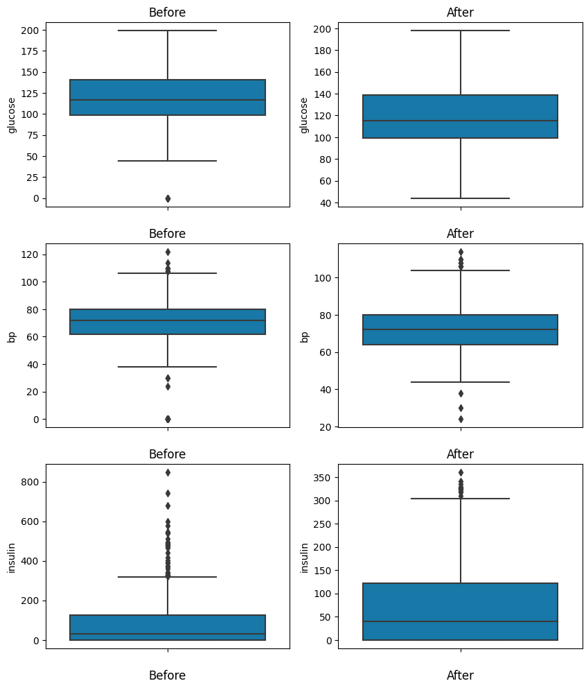
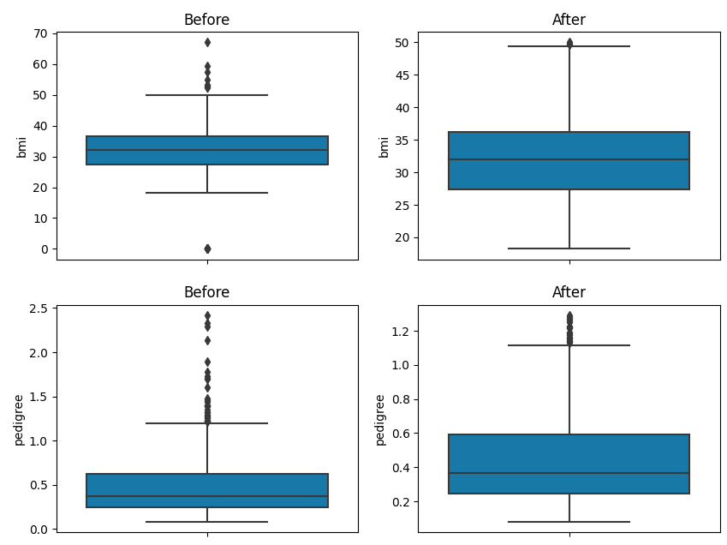
Data Preprocessing
We have changed the categorical values into numeric values.
We handled outliers using z-score method.

Slide 7
Selecting principal attributes
We trained random forest model with our training data then we’ve used .feature_importance__ to select the principal attributes.
We’ve dropped insulin and bp attribute as they contains lower feature importance.

Slide 8
ModelS used
The Machine Learning models used for this project are:
Random Forest
K – NN Classification
Naive Bayes ( Gaussian )
Decision Tree
Regression ( Logistic )

Slide 9
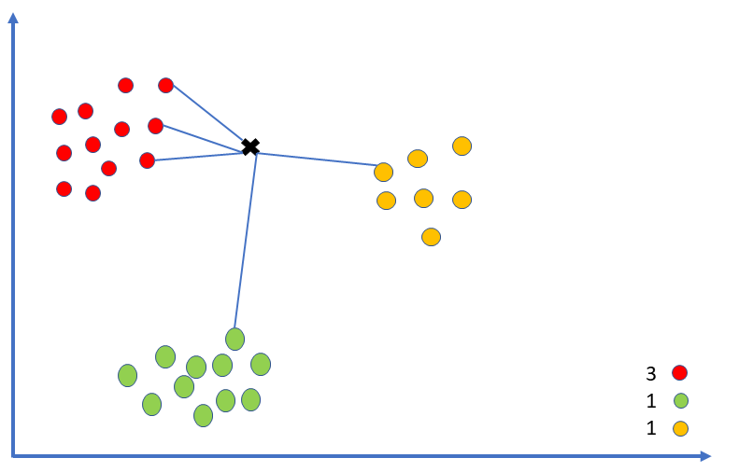
K – nn Classification
A k-nearest-neighbor algorithm, often abbreviated k-nn, is an approach to data classification that estimates how likely a data point is to be a member of one group or the other depending on what group the data points nearest to it are in.

Slide 10
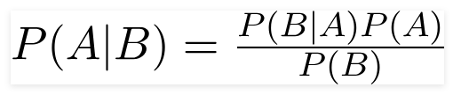
Naive Bayes
Principle of Naive Bayes Classifier :
A Naive Bayes classifier is a probabilistic machine learning model that’s used for classification task. The crux of the classifier is based on the Bayes theorem.
Bayes Theorem:
To find the probability of A happening, given that B has occurred.
Gaussian Naive Bayes:
Gaussian Naïve Bayes is the extension of naïve Bayes. While other functions are used to estimate data distribution, Gaussian or normal distribution is the simplest to implement as you will need to calculate the mean and standard deviation for the training data.

Slide 11
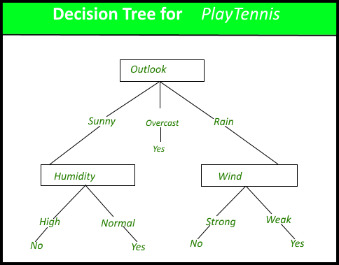
Decision tree
A decision tree is a very specific type of probability tree that enables you to make a decision about some kind of process.
It’s utilized for both classification and regression tasks. It has a hierarchical, tree structure, which consists of a root node, branches, internal nodes and leaf nodes.

Slide 12
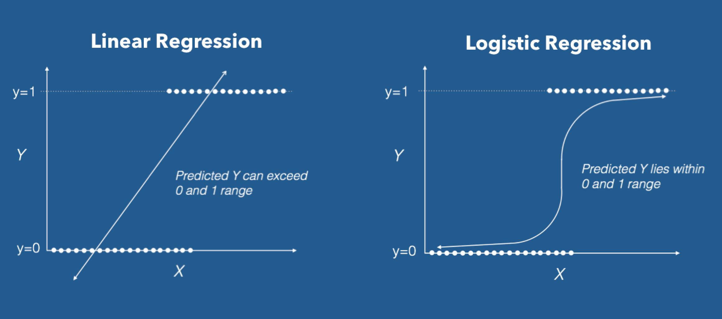
Logistic regression
Logistic Regression Logistic Regression is a Machine Learning algorithm which is used for the classification problems, it is a predictive analysis algorithm and based on the concept of probability.
The hypothesis of logistic regression tends it to limit the cost function between 0 and 1. Therefore linear functions fail to represent it as it can have a value greater than 1 or less than 0 which is not possible as per the hypothesis of logistic regression.

Slide 13

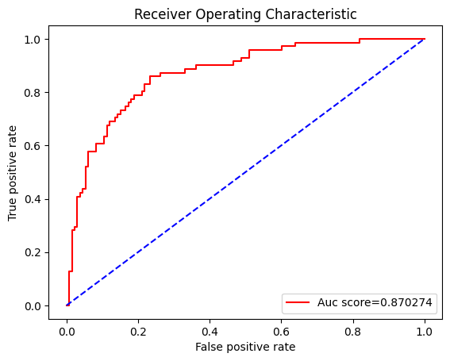
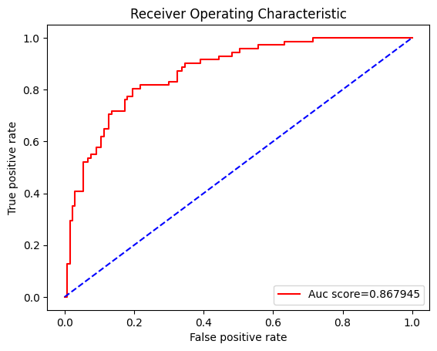
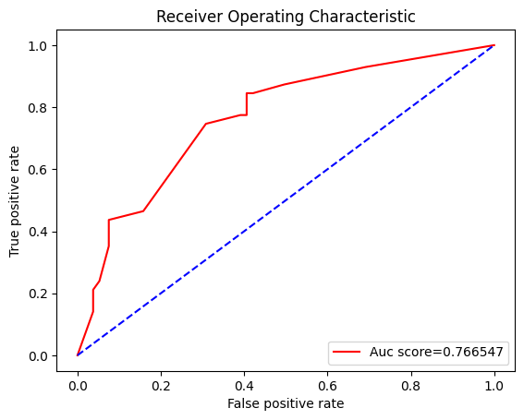
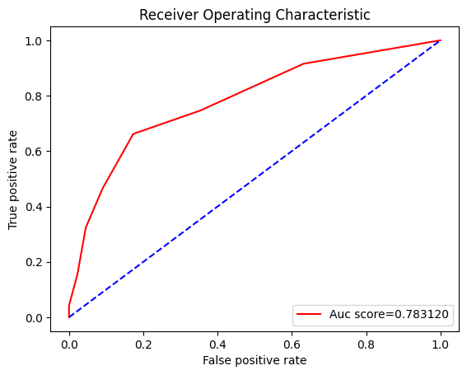
Receiver Operating characteristic curves
Gaussian Naive Bayes
Logistic Regression
Decision Tree
K - NN

Slide 14
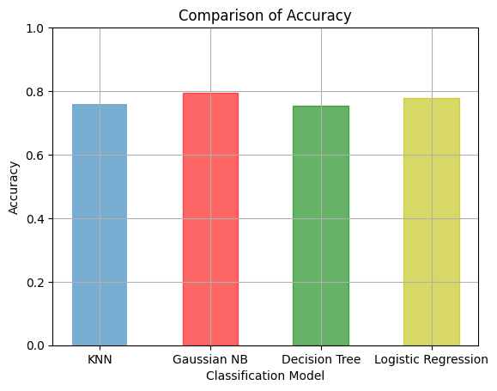
Accuracy comparison graph
Models Used | Accuracy %
Logistic Regression | 77.94
Gaussian Naive Bayes | 79.41
Decision Tree | 75.49
K – Nearest Neighbor | 75.49
The data shown above is an average of multiple test runs.
We see that the highest accuracy for the train dataset is Gaussian Naive Bayes.
So we select Gaussian Naive Bayes model for our user interface implementation.

Slide 15
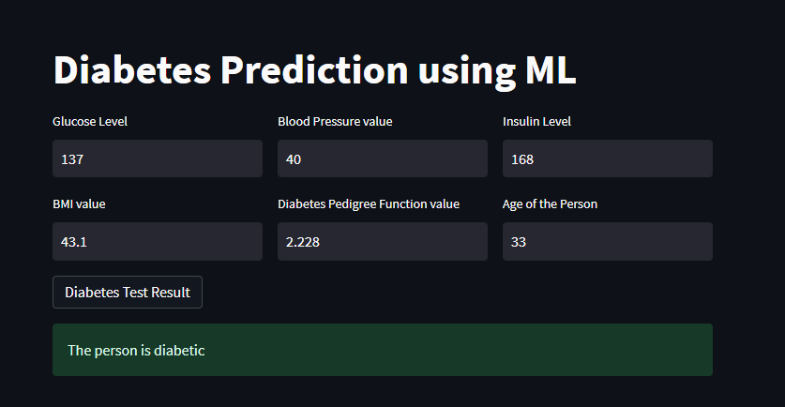
User interface

Slide 16
Future scope of improvements
Various hospital institution can use these models to automate the process of checking diabetes.
Patients can check their diabetes status by themselves.
Insulin and bp has very low feature importance, so for more accuracy in future we need to use larger dataset for training.

Slide 17
Thank you

